Slide 1

Data Visualization The Coffee Chain Analysis
Xinqi Zhuo

Slide 2

Outlines
Introduction
Research questions
Opportunities for future work
Tools and Datasets
Data Visualization Way
Data Visualization Presentation
SWOT Analysis
Summary
Appendix

Slide 3
Introduction
A value chain analysis provides the companies with a view of the activities in their production process. Managers can find out which parts can be optimized for better performance.

Slide 4

Research Questions
Total Sales by Market and by States
Which product type has the maximum sales and minimum sales in different market region?
What is the Market Size for each state with their profit?
What is the average expenses and profit for each state?
What is the total sales and total profits trend in 2013,2014,2015,2016 (in total and in average)?
Which state has the most profit?

Slide 5
Opportunities for future work
Collaboration/Partnership
A further critical driver, which ties into the industry’s focus on growth and product/service innovation, has been collaboration and partnership.
Education About Coffee
Coffee shop companies should start or continue to educate the consumers about coffee, its ingredients, quality differences, and about the movements in the market, such as “Fair Trade” or “organic coffee”. This could be beneficial for developing a relationship with the customers which in turns leads to greater brand loyalty.
Meeting Demand
Companies in the coffee shop industry have to make sure that they can meet the increasing future demand.

Slide 6
Tools and Dataset
Tableau for interactive map
Dataset named Tableau Coffee Chain downloaded from website:
https://drive.google.com/file/d/1O7u9EHrZhl66ngKRmcTa636V64UlkKGR/view
Clean all the data

Slide 7
Research Questions | Data Visualization way | Reasons
Total Sales by Market and by States | Map Circle size | Color shows details about different Markets effectively. Circle size indicates the quantity of total sales.
Which product type has the maximum sales and minimum sales in different market region? | Bar Plot Map Gradient color shading | Easy to compare sets of data between different groups at a glance. Gradient color shading will show the different quantity directly from colors. The map can clearly see the different regions.
What is the average expenses and profit for each state? | Line plot | Shows frequency of data along a number line It is a quick, simple way to organize data.
What are the sales and total profit trend in 2013,2014,2015,2016 (in total )? | Trend Line plot | Trend lines can be used to identify positive and negative trending charts.
Which state has the most sales and profits? | Dual axis bar plot and line plot | Easy to compare sets of data between different groups at a glance.
Which types of product have the most Inventory? | Line plot | See the difference among groups
Difference between Sales and Budget Sales | Dual Horizontal Bar chart | Easy to compare sets of data between different groups at a glance.
Difference between Profits and Budget Profits | Dual horizontal bar chart | Easy to compare sets of data between different groups at a glance.

Slide 8
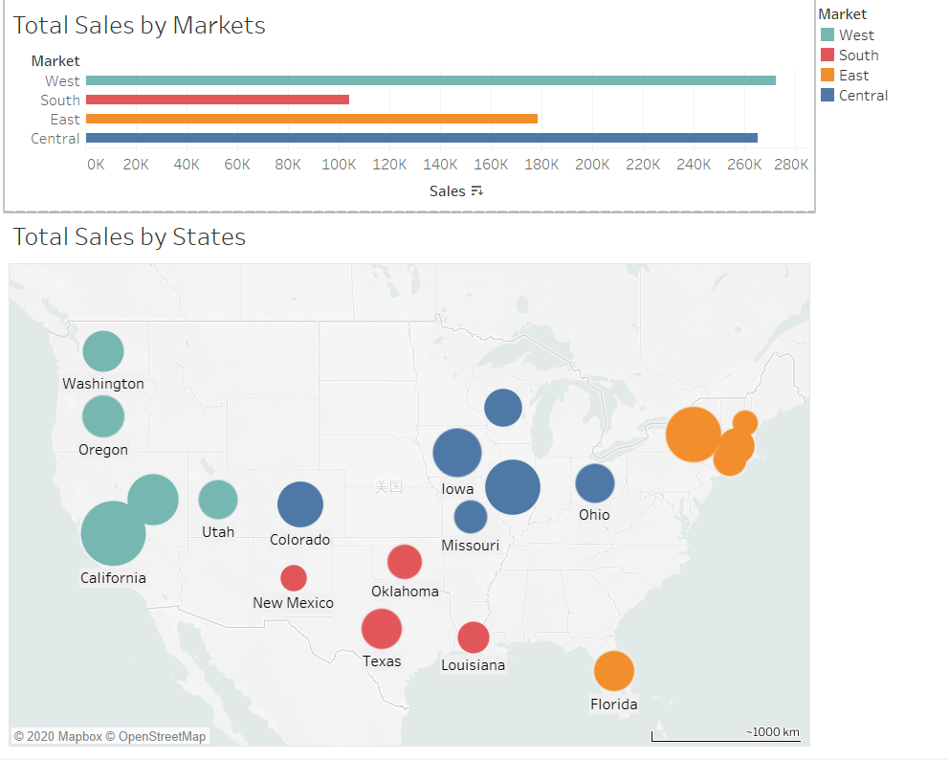
Total Sales by Markets and States
Graph shows that the West has the most sales among the four markets.
California has the biggest sales in the West Market.
This will help managers to decide which region should provide more products.
Notes:
Map based on Longitude (generated) and Latitude (generated). Color shows details about Market. Size shows sum of Sales. The marks are labeled by State. The data is filtered on Action (Market) and Action (Product Type, Product). The Action (Market) filter keeps 4 members. The Action (Product Type, Product) filter keeps 13 members.
Sum of Sales for each Market. Color shows details about Market. The data is filtered on Action (Market,State) and Action (Product Type,Product). The Action (Market,State) filter keeps 20 members. The Action (Product Type,Product) filter keeps 13 members.

Slide 9
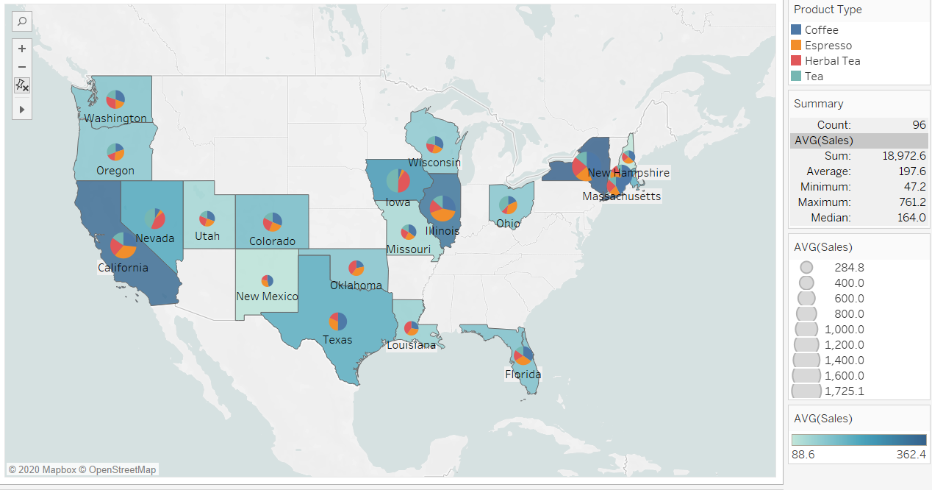
Which product type has the maximum sales and minimum sales in different market region?
Graph shows that at east cost coffee, at the west Herbal Tea and in the middle zone espresso is in high demand.
Pie characteristics sales generated from each product in that particular state.
This will help managers to decide which product can be sold more/sell in which state.
Notes:
Map based on Longitude (generated) and Latitude (generated) and Latitude (generated). For pane Latitude (generated): Color shows sum of Sales. Details are shown for State. For pane Latitude (generated) (2): Color shows details about Product Type. Size shows sum of Sales. The marks are labeled by State. The view is filtered on Product Type, which keeps Coffee, Espresso, Herbal Tea and Tea.

Slide 10
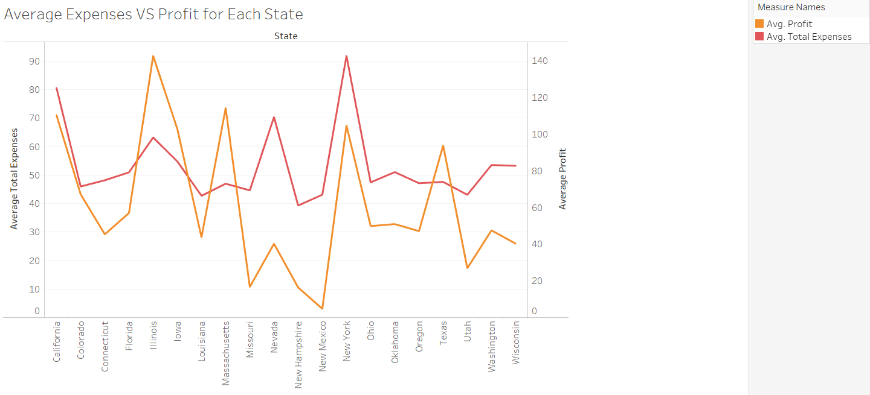
What is the average expenses and profit for each state?
Average expense for Illinois is 63.21 whereas profit is 142.7. This indicates that Illinois is generating more profit at less expense.
Similarly other states are generating good profit as compare to their expenditure.
States like Missouri, Nevada, New Hampshire, New Mexico, Utah, Washington and Wisconsin are in loss. They are spending more but getting less output.
New York has the largest sales but is not making great differences at cost of expenditure.
Thus this graph tells us to change revenue model for states that are in loss.
Notes:
The trends of Avg. Total Expenses and Avg. Profit for State. Color shows details about Avg. Total Expenses and Avg. Profit. The data is filtered on Action (Product Type, Product), Action (Market) and Action (Market, State). The Action (Product Type, Product) filter keeps 13 members. The Action (Market) filter keeps 4 members. The Action (Market, State) filter keeps 20 members.

Slide 11
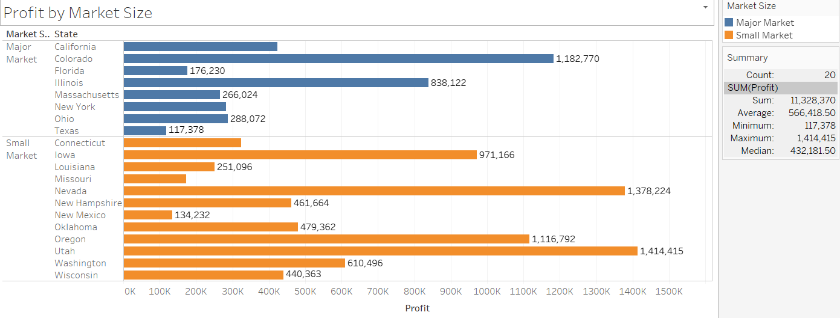
What is the Market Size for each state with their profit?
Managers can identify which state falls under major and minor market.
It will help to decide what should be COGS in future for the major and minor size.
It will help people in predicting the profit based on the market size.
Notes:
Sum of Profit for each State broken down by Market Size. Color shows details about Market Size. The marks are labeled by sum of Profit. The data is filtered on Action (Market,State), Action (Market) and Action (Product Type,Product). The Action (Market,State) filter keeps 20 members. The Action (Market) filter keeps 4 members. The Action (Product Type,Product) filter keeps 13 members.

Slide 12

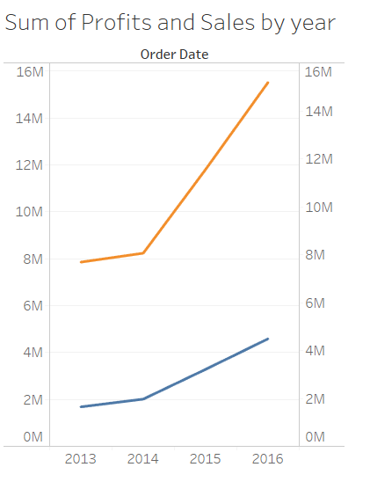
What are the sales and total profit trend in 2013,2014,2015,2016 (in total )?
From 2013 to 2014, both the sales and the profits slightly rose, and from 2014 to 2016， the growth of the sales and the profits accelerated.
The increase in sales was quicker than the rise in profits. This reveals that the costs raised faster than the profits. Some unnecessary expenses and increasing human costs lead to the result.
Notes:
The trends of Sales (factTable) and Profit (factTable) for Order Date Year. Color shows details about Sales (factTable) and Profit (factTable).

Slide 13
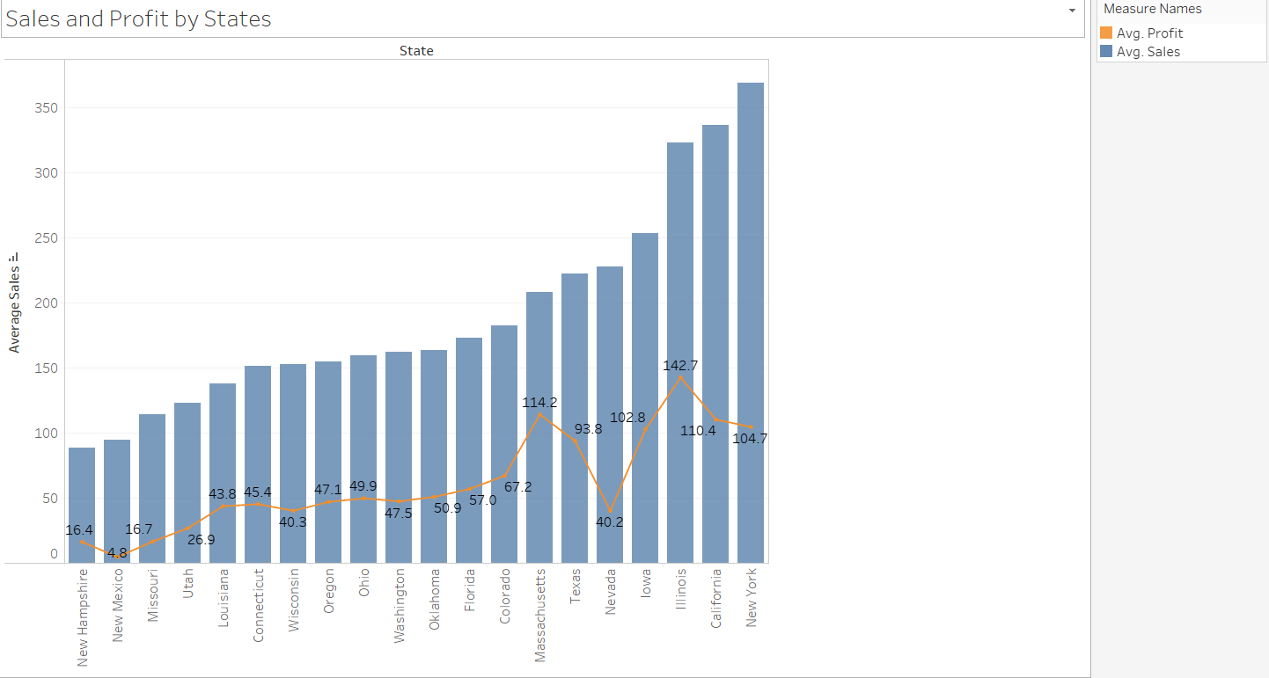
Which state has the highest sales and profits?
New Hampshire had the lowest sales;
New York had the highest sales;
New Mexico had the lowest profits;
Illinois had the highest profits.
Notes:
The trends of Avg. Sales and Avg. Profit for State. Color shows details about Avg. Sales and Avg. Profit.

Slide 14
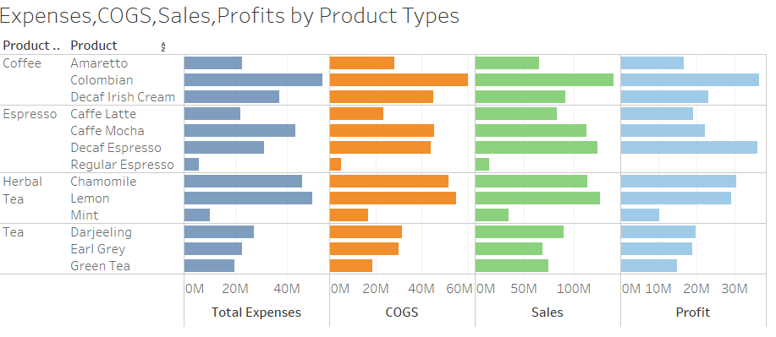
Expenses, COGS, Sales, Profits by Product Types
Notes:
Sum of Total Expenses (Sheet1 ), sum of COGS (Sheet1 ), sum of Sales (Sheet1 ) and sum of Profit (Sheet1 ) for each Product broken down by Product Type.

Slide 15
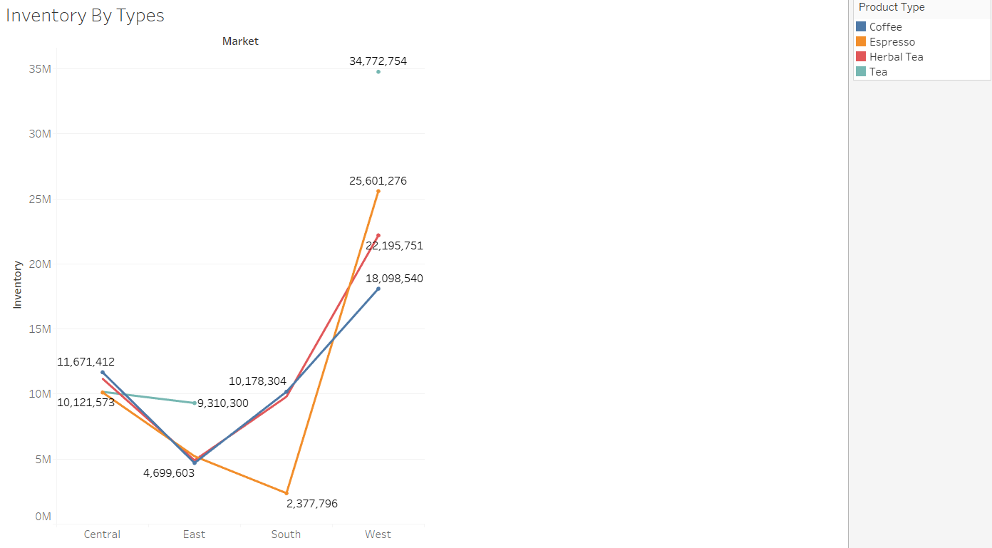
Inventory By Types
The west market has the highest inventory of all the product types. Central has the second-highest inventory.
According to the graph, managers can decide how to make some arrangement on the inventory when the product are inflected by bad weather.
Notes:
The trend of sum of Inventory for Market. Color shows details about Product Type. The data is filtered on Action (Market) and Action (Market, State). The Action (Market) filter keeps 4 members. The Action (Market, State) filter keeps 20 members.

Slide 16
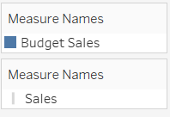
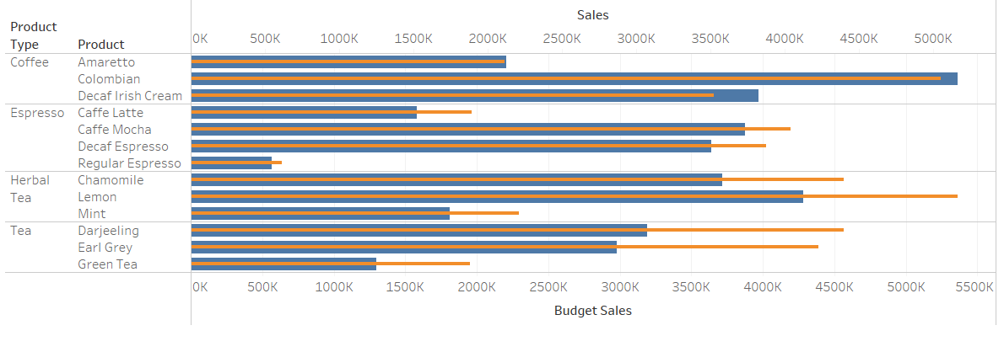
Sales by Budget Sales
The actual sales of Lemon herbal tea, Darjeeling tea, and earl grey tea have exceeded the budget sales overly.
The graph suggests managers not only focus on continuing to make more traditional coffee products but also pay attention to the herbal tea portion.
Notes:
Budget Sales and Sales for each Product broken down by Product Type. For pane Sum of Sales: Size shows details about Budget Sales and Sales. For pane Sum of Budget Sales: Color shows details about Budget Sales and Sales. The view is filtered on Product and Product Type. The Product filter keeps 13 of 13 members. The Product Type filter keeps Coffee, Espresso, Herbal Tea and Tea.

Slide 17
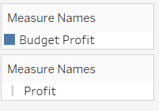
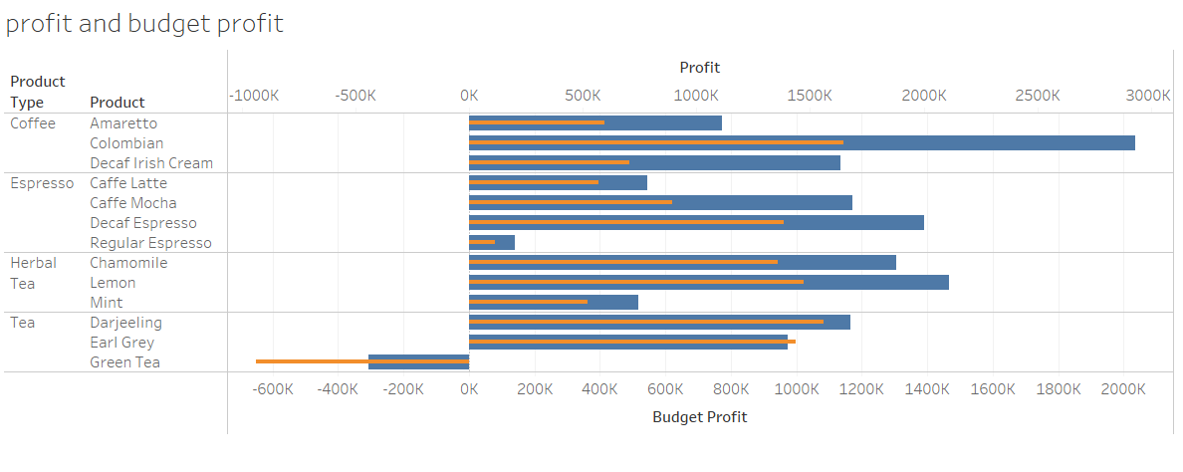
Profits by Budget Profits
Tea products, especially the green tea, has terrible performance on profit. Managers need to practice some actions to reduce the loss, like lowering costs on unnecessary expenses and increasing the advertisement.
Colombian coffee and decaf Irish cream have very stable business performance. Managers should obtain good experience from these products.
Notes:
Budget Profit and Profit for each Product broken down by Product Type. For pane Sum of Budget Profit: Color shows details about Budget Profit and Profit. For pane Sum of Profit: Size shows details about Budget Profit and Profit. The data is filtered on Action (Market,State) and Action (Market). The Action (Market,State) filter keeps 20 members. The Action (Market) filter keeps 4 members. The view is filtered on Product Type and Product. The Product Type filter keeps Coffee, Espresso, Herbal Tea and Tea. The Product filter keeps 13 of 13 members.

Slide 18
SWOT Analysis
-Unique flavors
-Beans imported from different places
-Prices
-Customer’s being willing to purchase depends on weather
-New styles of drinks
-Rising Competitors
-Competitor’s prices

Slide 19
Summary
At East cost coffee, at the west coast Herbal Tea and in the middle zone Espresso is in high demand. California has the biggest sales in the West Market. This will help managers to decide which region should provide more products and to decide which product can be sold more/sell in which state.
According to the inventory graph, managers can decide how to make some arrangement on the inventory when the product are inflected by bad weather.
Managers can identify which state falls under major and minor market, which will help to decide what should be COGS in future for the major and minor size and to predict the profit based on the market size.
the average expenses and profit for each state tells us to change revenue model for states that are in loss.

Slide 20
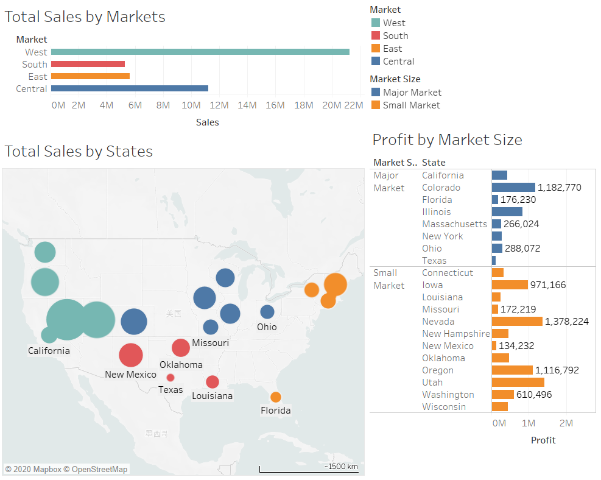
Appendix

Slide 21
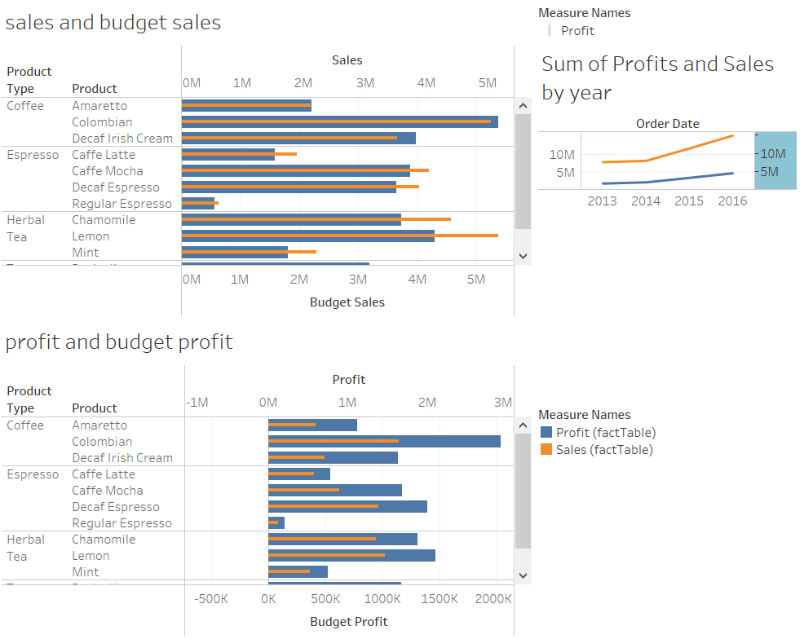
Appendix

Slide 22
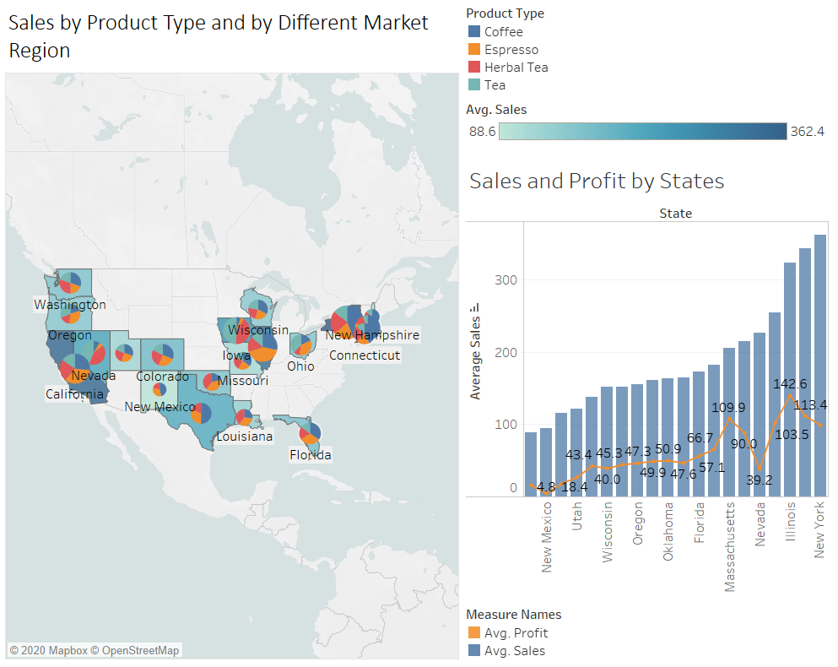
Appendix

Slide 23
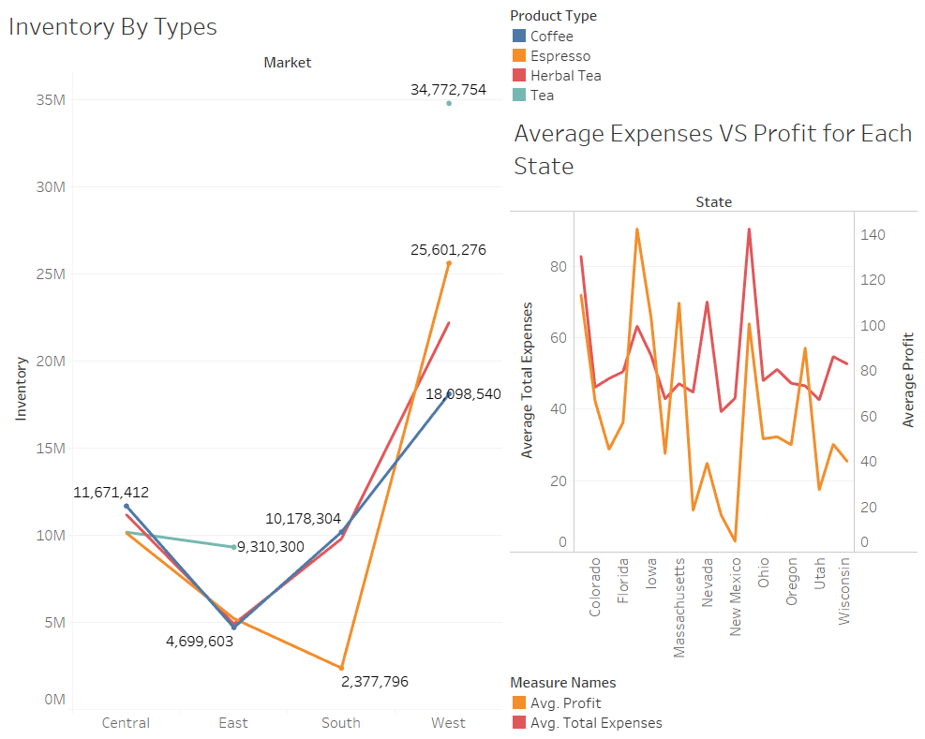
Appendix

Slide 24
THANK YOU !

